Slide 1

STATS 250 Lab 5
Jiangyue

Slide 2
Course Reminders
Assignment | Due Date
Lab 5 | Thursday, March 16th by 11:59pm
Homework 5 | Thursday, March 16th by 11:59pm
In Lab 6, you will create all the output needed for M-Write #2
So be sure to attend!

Slide 3
Lab 5
Learning Objectives
Review of the sampling distribution of the sample mean
Check for normality using QQ plots
Understand when to apply the Central Limit Theorem (CLT)
Estimate one population mean with a confidence interval
Carry out a hypothesis test for one population mean

Slide 4
Lab 5
Head to https://rstudio.cloud/
If you are not signed in…
Click on “Log In”
Click “Log In with Google”
Log In with your UM credentials
Click the “Start” button next to the “lab05” assignment

Slide 5































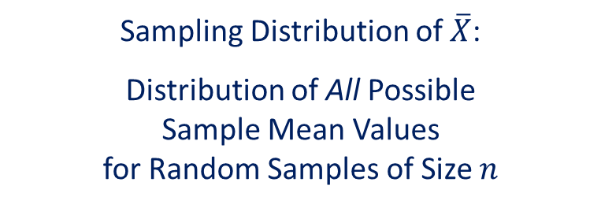
















Sampling Distribution of $\overline{X}$
Let’s revisit the sampling distribution of the sample mean
Knowing the center, spread, and shape of this distribution helps us create confidence intervals and run hypothesis tests for a mean!
Sampling Distribution of $\overline{X}$:
Distribution of All Possible
Sample Mean Values
for Random Samples of Size $n$
$$\overline{x}$$
$$\overline{x}$$
$$\overline{x}$$
$$\overline{x}$$
$$\overline{x}$$
$$\overline{x}$$
$$\overline{x}$$
$$\overline{x}$$
$$\overline{x}$$
$$\overline{x}$$
$$\overline{x}$$
$$\overline{x}$$
$$\overline{x}$$
$$\overline{x}$$
$$\overline{x}$$
$$\overline{x}$$
$$\overline{x}$$
$$\overline{x}$$
$$\overline{x}$$
$$\overline{x}$$
$$\overline{x}$$
$$\overline{x}$$
$$\overline{x}$$
$$\overline{x}$$
$$\overline{x}$$
$$\overline{x}$$
$$\overline{x}$$
$$\overline{x}$$
$$\overline{x}$$
$$\overline{x}$$
$$\overline{x}$$
$$\overline{x}$$
$$\overline{x}$$
$$\overline{x}$$
$$\overline{x}$$
$$\overline{x}$$
$$\overline{x}$$
$$\overline{x}$$
$$\overline{x}$$
$$\overline{x}$$
$$\overline{x}$$
$$\overline{x}$$
$$\overline{x}$$
$$\overline{x}$$
$$\overline{x}$$
$$\overline{x}$$

Slide 6
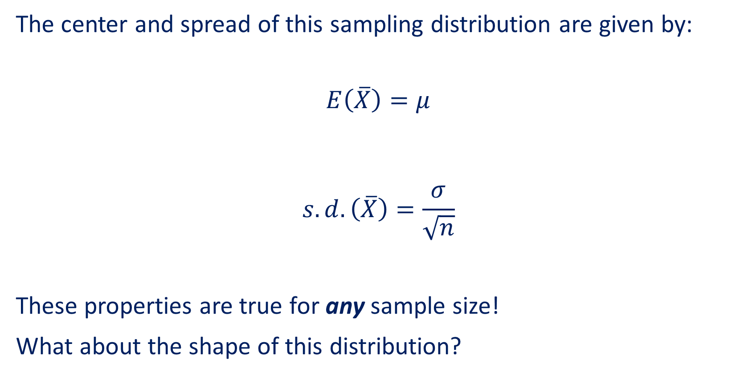

Sampling Distribution of $\overline{X}$
The center and spread of this sampling distribution are given by:
$$E\left(\overline{X}\right)=μ$$
$$s.d.\left(\overline{X}\right)=\frac{σ}{\sqrt{n}}$$
These properties are true for any sample size!
What about the shape of this distribution?

Slide 7
Think About It
True or False?
In order for the sampling distribution of the sample mean to be normal (or approximately normal), the sample size must be at least 25

Slide 8

Sampling Distribution of $\overline{X}$
False!
If $X$ has a $Normal\left(μ, σ\right)$ distribution,
then the Sampling Distribution of $\overline{X}$ is $Normal\left(μ, \frac{σ}{\sqrt{n}}\right)$
This is true for any sample size!

Slide 9
Checking for Normality
We can use the sample of data to make assumptions about the population it was drawn from
If the sample appears to follow a normal model, then it is reasonable for us to assume that this sample was drawn from a normally distributed population
If the sample does not appear to follow a normal model, then it is not reasonable for us to assume that this sample was drawn from a normally distributed population
And if we can assume the sample was drawn from a normally distributed population, we can assume the sampling distribution of the sample mean is normal! (According to the property from the last slide)

Slide 10
NHANES Data
National Health and Nutrition Examination Survey
- height: height (in cm)
- weight: weight (in kg)
- BMI: body mass index (in kg/m^2)
- arm: arm circumference (in cm)
- chol: cholesterol level (in mg)
- iron: iron level (in mg)
- hgb: hemoglobin (in g/dL)
- caffeine: caffeine amounts (in mg)
- rbcc: red blood cell count (in millions of cells/uL)
- wbcc: white blood cell count (in millions of cells/uL)

Slide 11
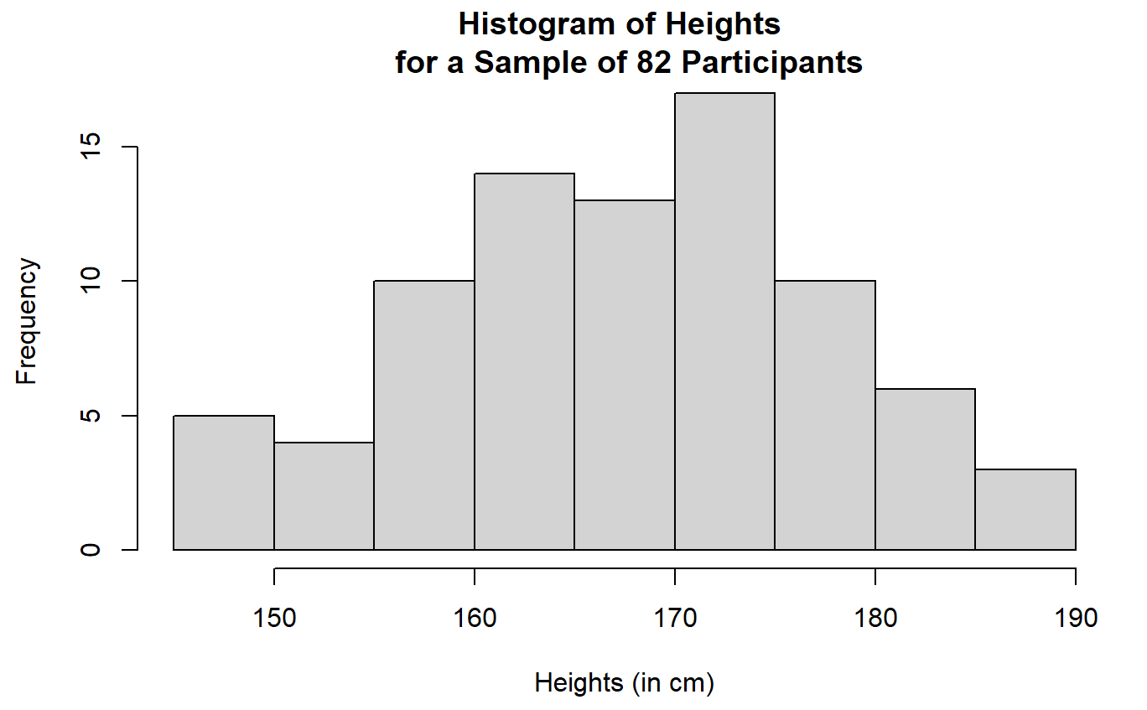
Histograms
We can use histograms to help check for normality
The sample of heights looks approximately bell-shaped!

Slide 12
Conclusion
What does this mean?
Conclusion about the sample: Our sample of heights appears to follow a normal model because the histogram is approximately bell-shaped
Conclusion about the population (that the sample was drawn from): Because the sample appears to follow a normal model, we can assume that this sample was drawn from a normally distributed population of heights
Conclusion about the sampling distribution of the sample mean: Because we can assume the population of heights is normally distributed, we can assume that the sampling distribution of the sample mean is normal
What do these conclusions imply about the inference procedure? Because we can assume that the sampling distribution of the sample mean is normal, we can proceed with creating a confidence interval or running a hypothesis test for the population mean height

Slide 13
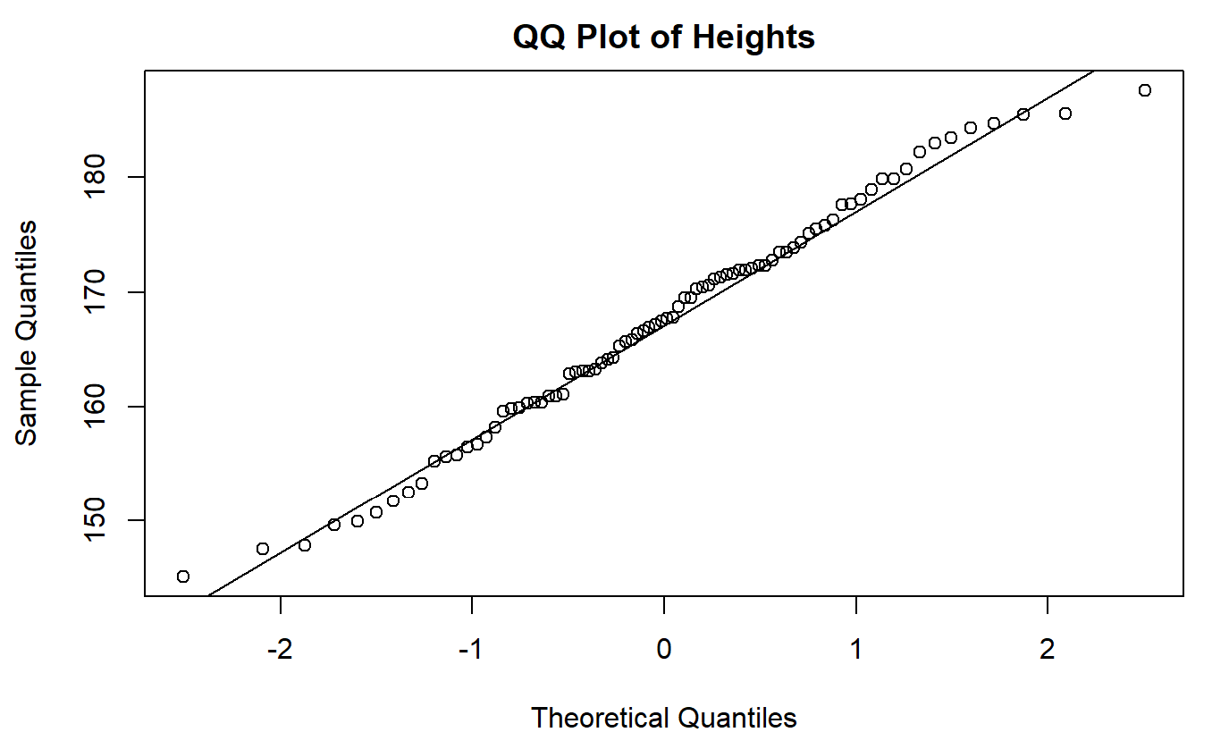
QQ Plots (Quantile-Quantile Plots)
Used to assess the normality of data
Compares our sample data to a theoretical normal distribution
Observations should approximately follow around and along the line
Notes:
Another popular plot used to check for normality is a QQ plot
There are no major deviations or obvious patterns.
Do the points line up perfectly on the line? No, and that’s okay! We should not expect the data to line up perfectly. Instead, we want to make sure there aren’t any major deviations or obvious patterns straying from the line. These are random samples, so we should always expect to see some deviations or imperfections.

Slide 14
Conclusion
What does this mean?
Conclusion about the sample: Our sample of heights appears to follow a normal model because the points approximately follow around and along the line
Conclusion about the population (that the sample was drawn from): Because the sample appears to follow a normal model, we can assume that this sample was drawn from a normally distributed population of heights
Conclusion about the sampling distribution of the sample mean: Because we can assume the population of heights is normally distributed, we can assume that the sampling distribution of the sample mean is normal
What do these conclusions imply about the inference procedure? Because we can assume that the sampling distribution of the sample mean is normal, we can proceed with creating a confidence interval or running a hypothesis test for the population mean height

Slide 15
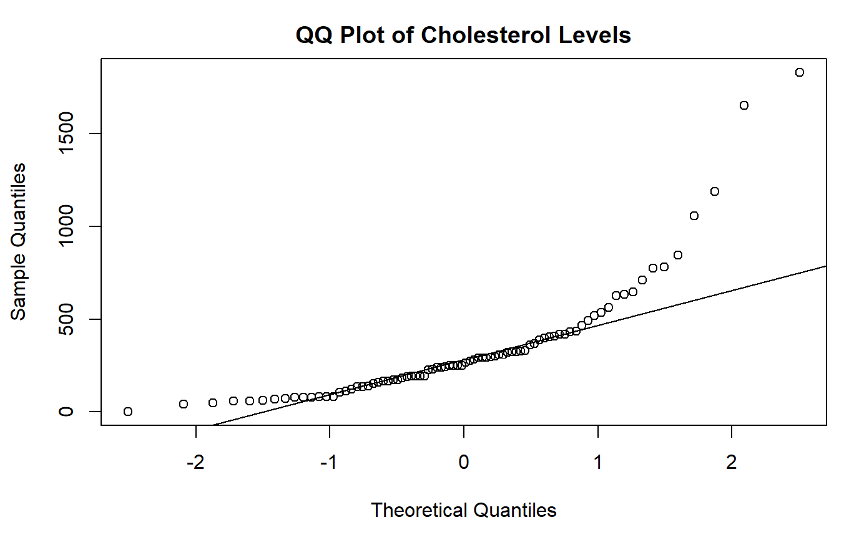
QQ Plots
What does a “bad” QQ plot look like?
A plot with severe deviations or clear patterns from the line

Slide 16
Conclusion
What does this mean?
Conclusion about the sample: Our sample of cholesterol levels does not appear to follow a normal model because the points pull away from the line in a severe manner
Conclusion about the population (that the sample was drawn from): Because the sample does not appear to follow a normal model, we cannot assume that this sample was drawn from a normally distributed population of cholesterol levels
What does this mean for the sampling distribution of the sample mean? We will discuss this in the next section. For now, let's get more practice with QQ plots.

Slide 17
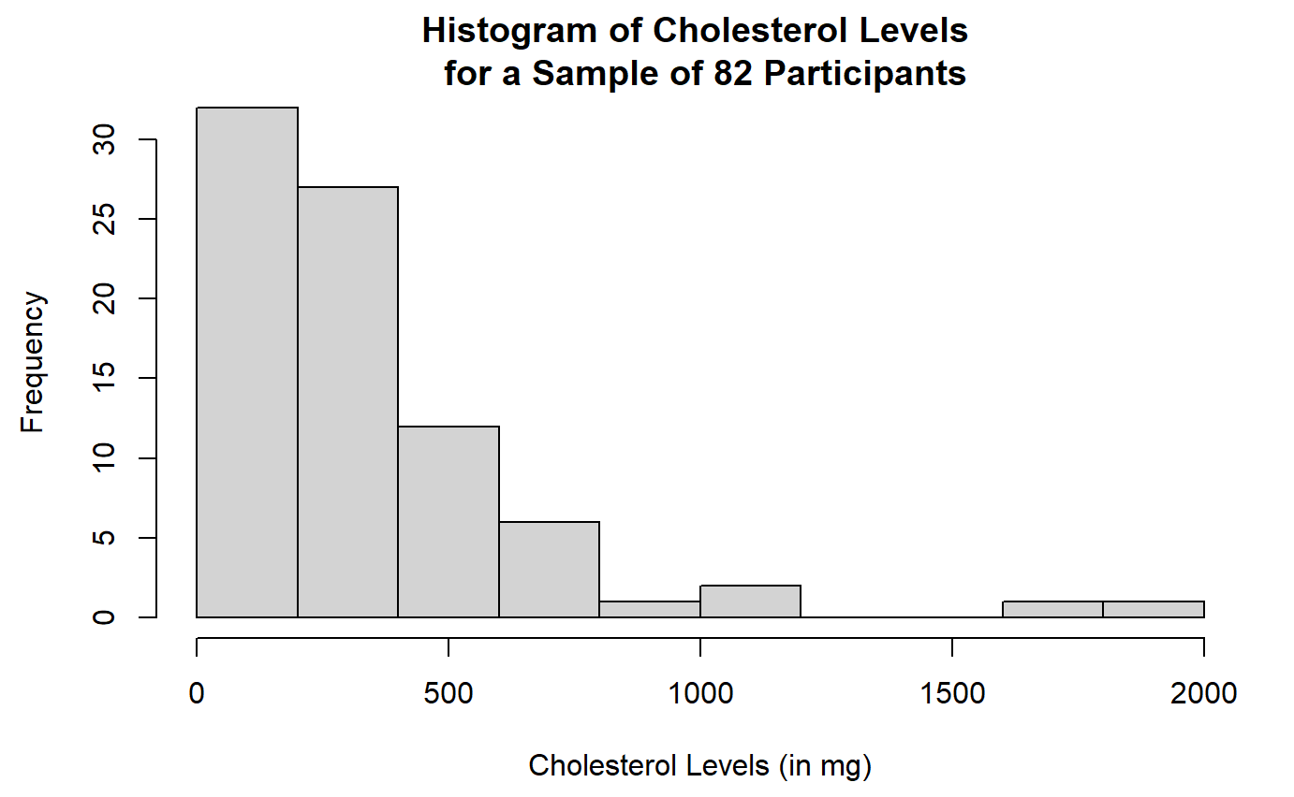
Comparison
What does the histogram look like for this data?

Slide 18
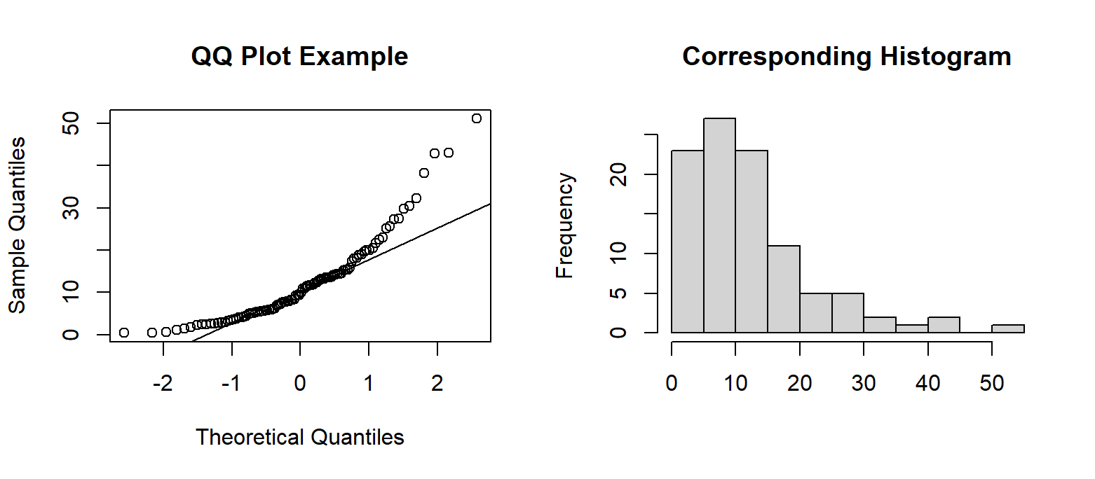
“Bad” QQ Plot Examples
The sample does not appear to follow a normal model

Slide 19
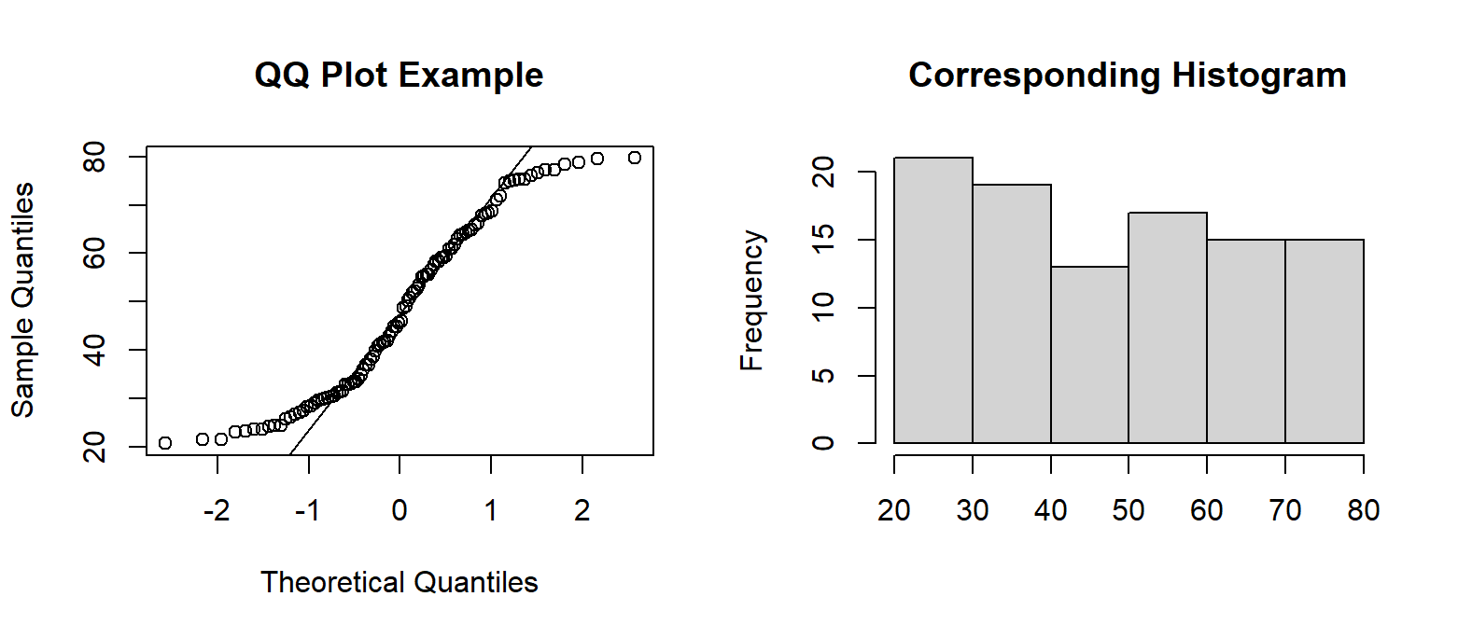
“Bad” QQ Plot Examples
The sample does not appear to follow a normal model

Slide 20
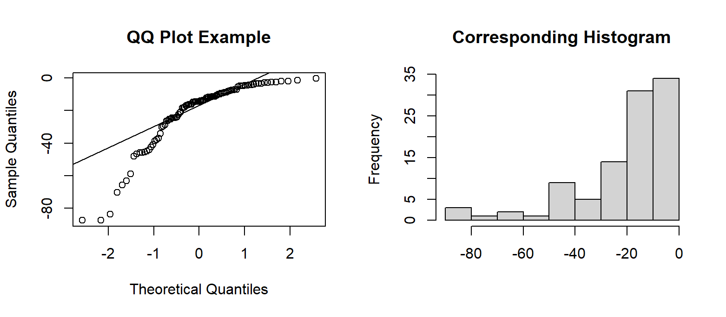
“Bad” QQ Plot Examples
The sample does not appear to follow a normal model
Notes:
you will not need to know which QQ plot patterns correspond to a left or right skewed histogram. Just know that we want the points to roughly follow along and around the line.

Slide 21
Demo #1
Create a QQ plot of red blood cell counts (rbcc) for the sample.
Think About It:
Does the sample of red blood cell counts appear to follow a normal model?
Could you assume that the sample was drawn from a normally distributed population of red blood cell counts?

Slide 22
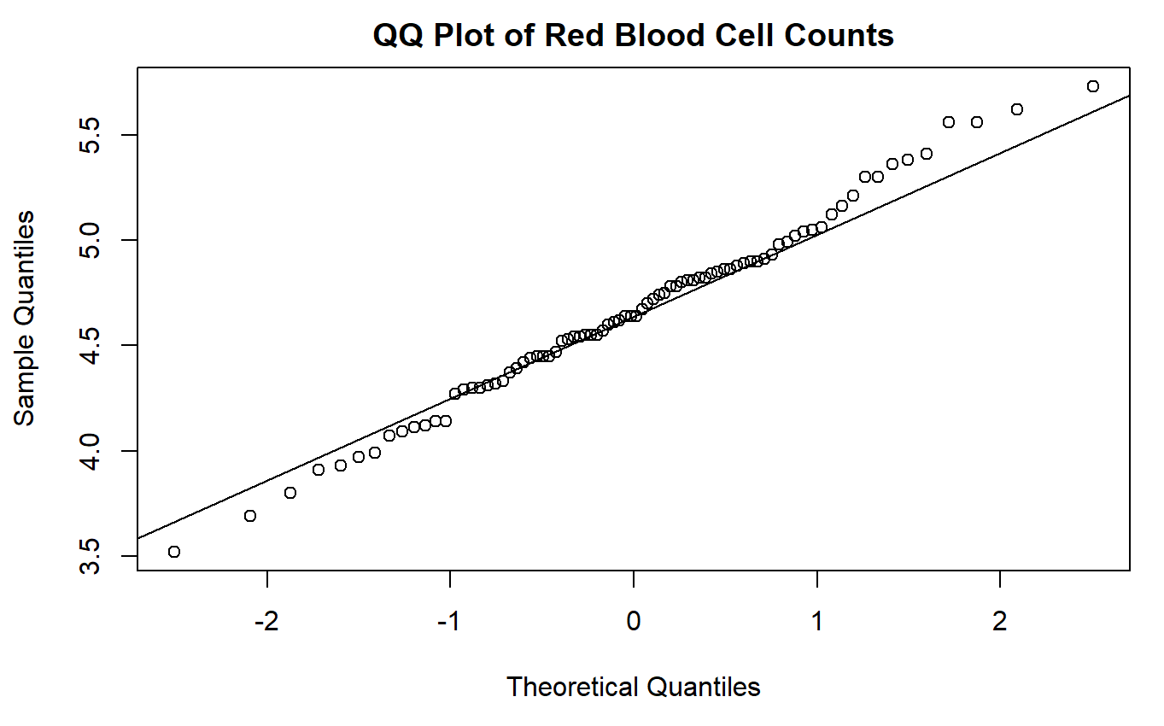
Demo #1
There are some small deviations from the line, but they aren’t severe! The sample of red blood cell counts appears to follow a normal model.
Notes:
because the points roughly follow along and around the line. We CAN assume that this sample was drawn from a normally distributed population!

Slide 23
Important Note
There can be some gray-area when checking for normality
If our sample was perfectly normal, the points would fall exactly on the straight line (this will never happen in reality)
Our data is a random sample
We should not expect the data to line up perfectly! Instead, we want to make sure there aren't any major deviations or clear patterns straying from the line

Slide 24
Think-Pair-Share #1
Think: individually reflect on the question
Pair: discuss with a small group
Share: discuss with the entire lab section
Which of the following is observed in the QQ plot above: the population of caffeine amounts for all NHANES participants, a sample of 82 caffeine amounts for 82 NHANES participants, or the distribution of all possible sample mean caffeine amounts?
Which of the following can we make assumptions for (based on the QQ plot above): the population of caffeine amounts for all NHANES participants, a sample of 82 caffeine amounts for 82 NHANES participants, or the distribution of all possible sample mean caffeine amounts?
What conclusions can be made from the plot?
Notes:
We are observing a SAMPLE of 82 caffeine amounts.
We can make assumptions for the population of all caffeine amounts and the distribution of all possible sample mean caffeine amounts.

Slide 25
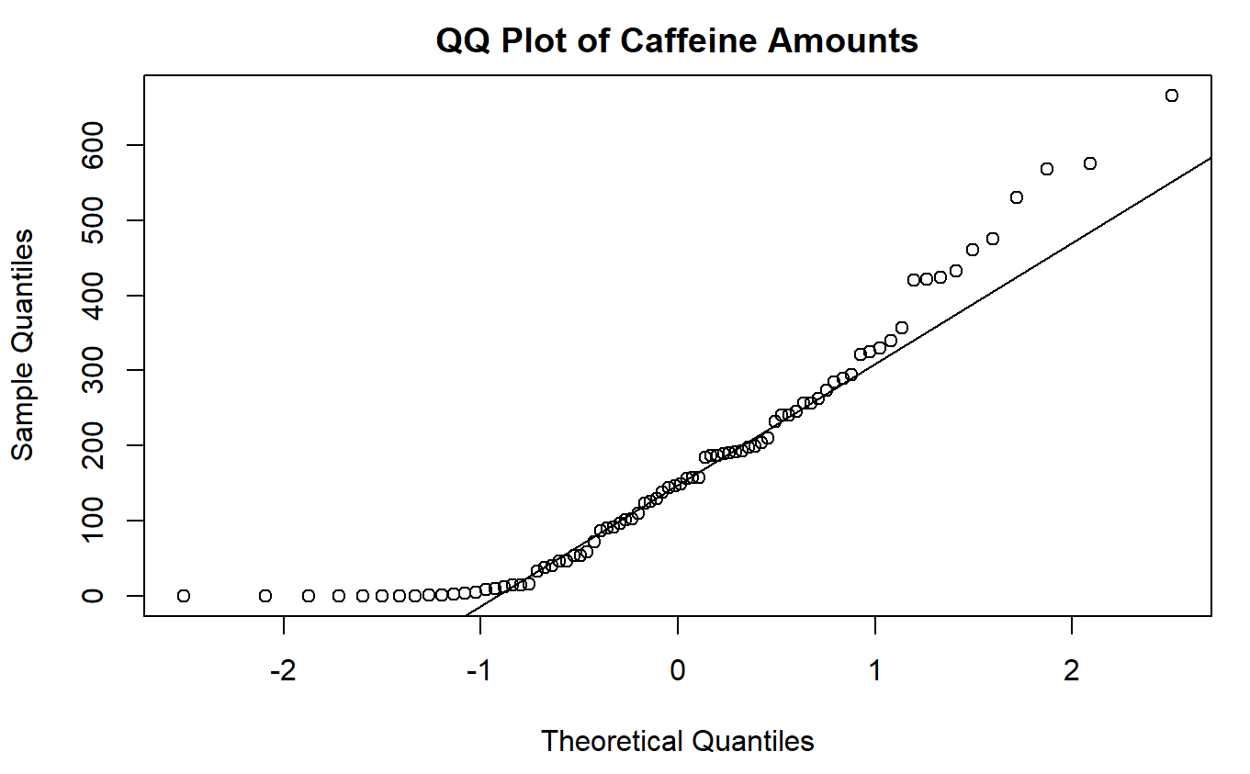
Think-Pair-Share #1
The sample does not appear to follow a normal model because the points pull away from the line severely in the lower tail
Notes:
Because the sample does not appear to follow a normal model, we CANNOT assume that this sample was drawn from a normally distributed population of caffeine amounts.
Important Disclaimer: Sometimes these plots will be difficult to interpret - they can be subjective and there can be quite a bit of gray area. Always be sure to justify your answer by describing what you see.

Slide 26
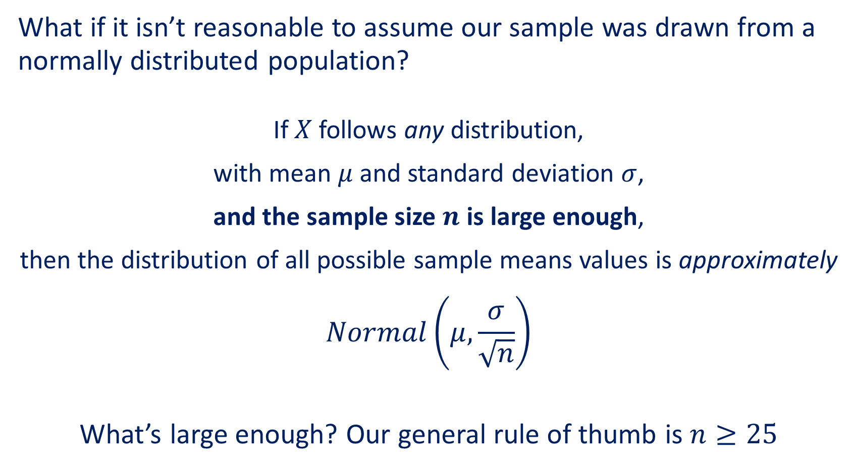
Central Limit Theorem
What if it isn’t reasonable to assume our sample was drawn from a normally distributed population?
If $X$ follows any distribution,
with mean $μ$ and standard deviation $σ$,
and the sample size $n$ is large enough,
then the distribution of all possible sample means values is approximately
$$Normal\left(μ, \frac{σ}{\sqrt{n}}\right)$$
What’s large enough? Our general rule of thumb is $n≥25$

Slide 27
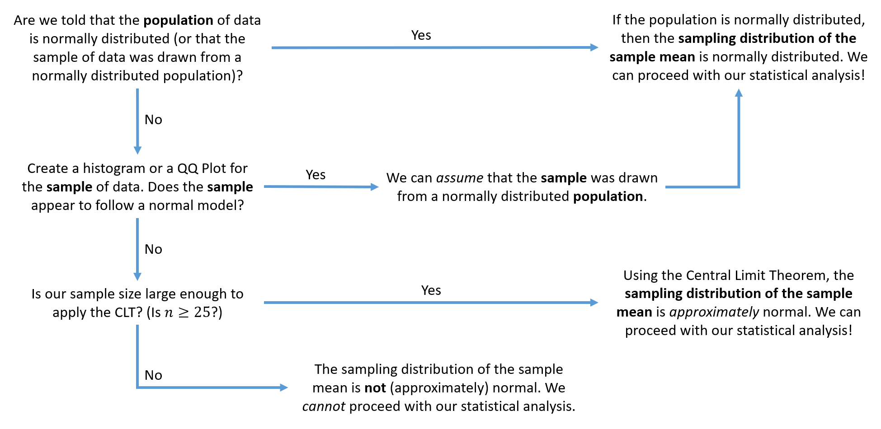
Normality Road Map

Slide 28

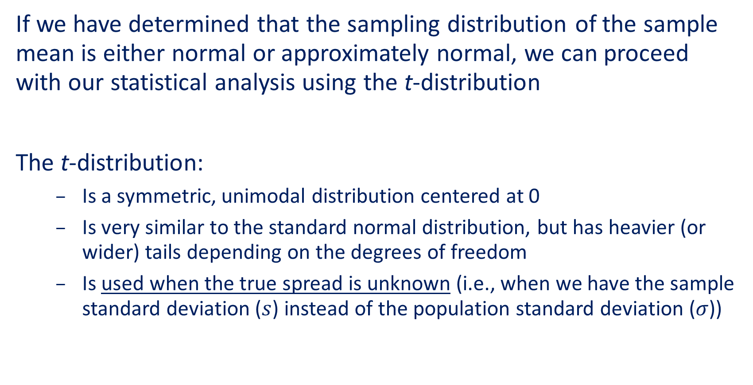
$t$-Distribution
If we have determined that the sampling distribution of the sample mean is either normal or approximately normal, we can proceed with our statistical analysis using the t-distribution
The t-distribution:
Is a symmetric, unimodal distribution centered at 0
Is very similar to the standard normal distribution, but has heavier (or wider) tails depending on the degrees of freedom
Is used when the true spread is unknown (i.e., when we have the sample standard deviation ($s$) instead of the population standard deviation ($σ$))
Notes:
$σ$ → z
$s$ → t

Slide 29
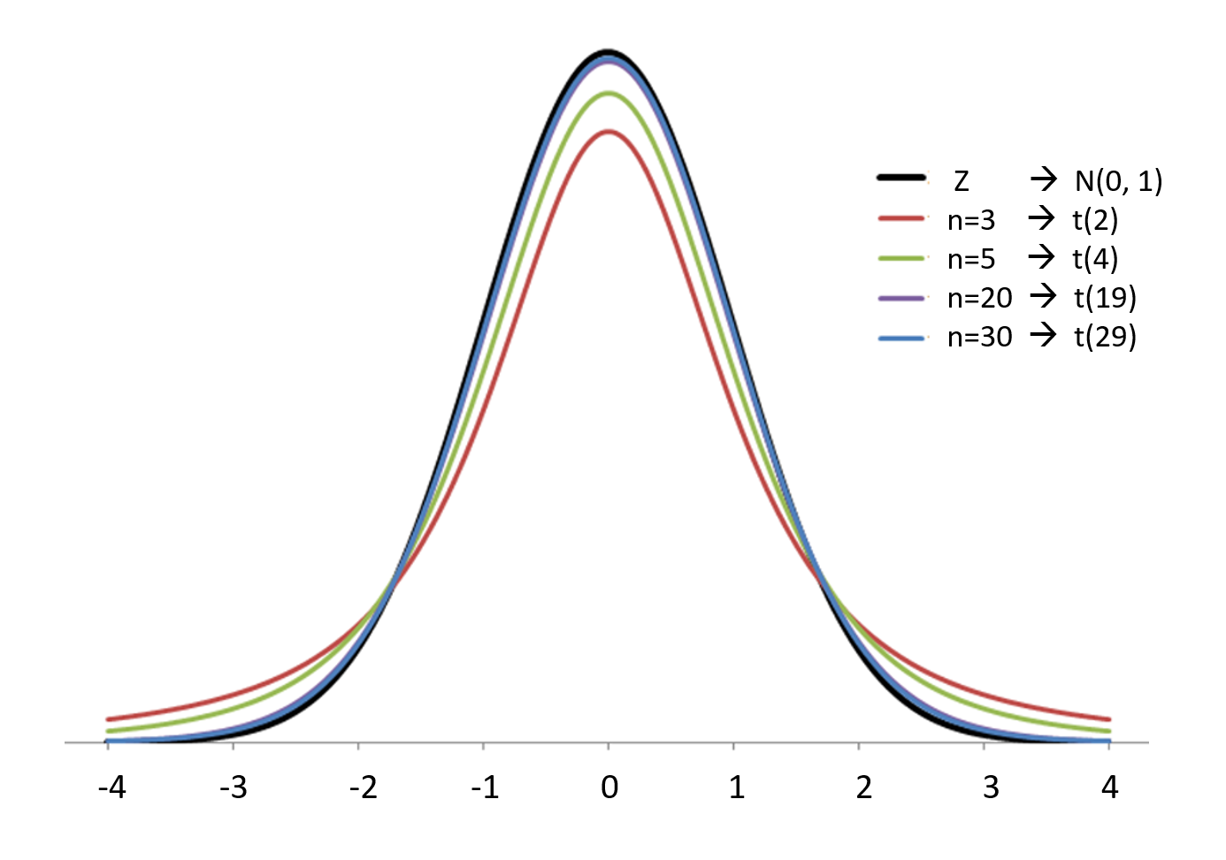

$t$-Distribution vs Standard Normal ($Z$)

Slide 30

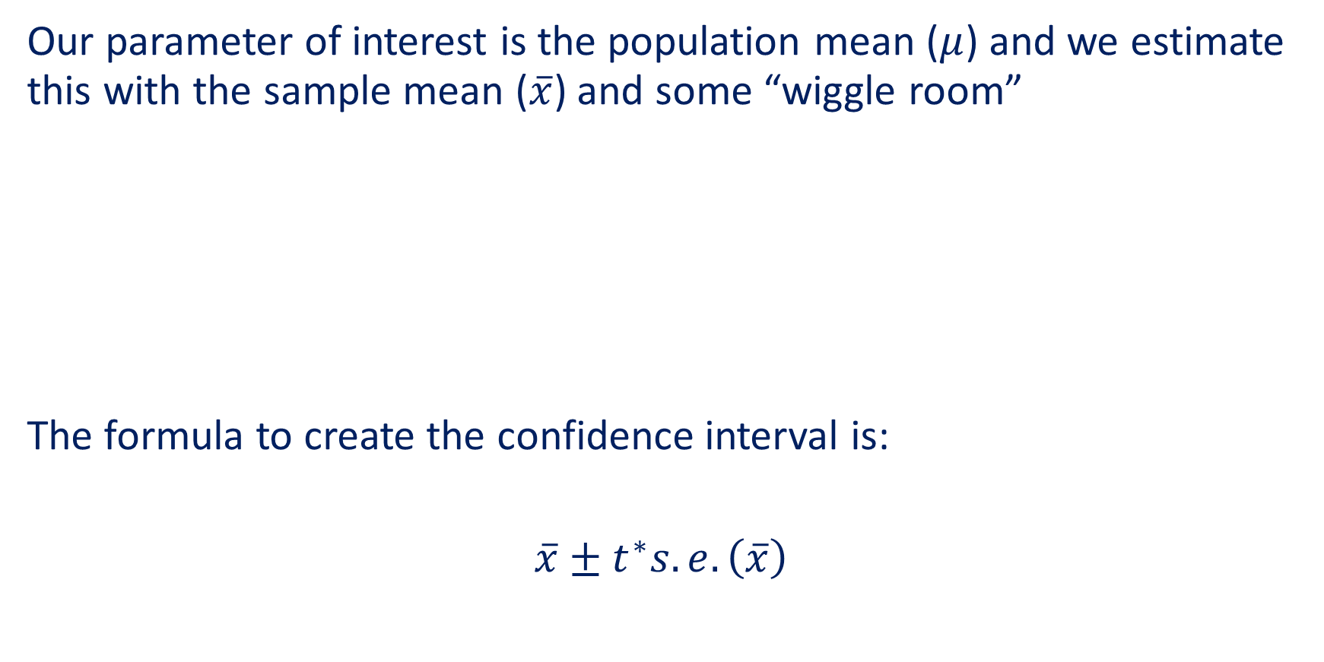


Confidence Intervals
Our parameter of interest is the population mean ($μ$) and we estimate this with the sample mean ($\overline{x}$) and some “wiggle room”
The formula to create the confidence interval is:
$$\overline{x}±t^{∗}s.e.\left(\overline{x}\right)$$
$$m$$
$$m$$
$$\overline{x}$$

Slide 31
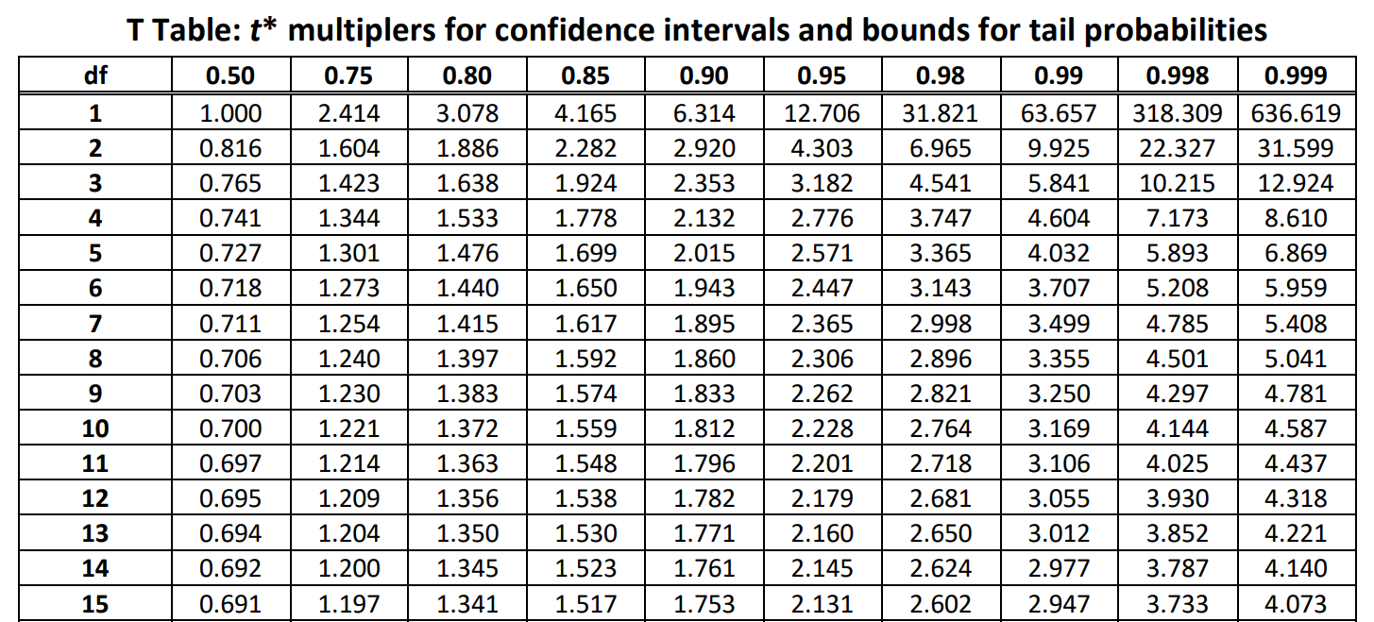

Finding the t* Multiplier
Degrees of freedom: $df=n−1$

Slide 32
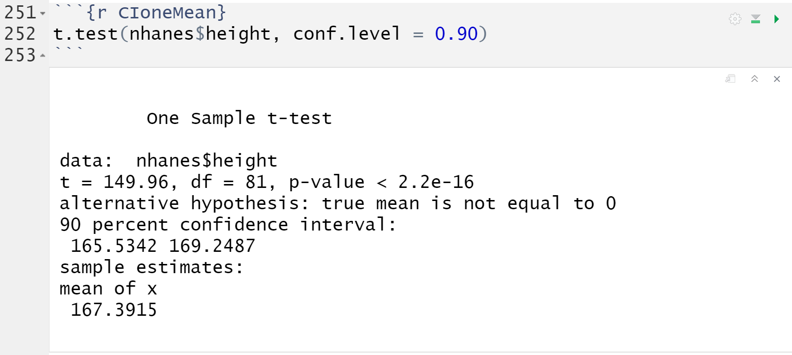
t.test()
To create a confidence interval for one population mean, we need:
The variable of interest (dataset$variable)
The desired confidence level (conf.level)

Slide 33
t.test()
The function gives us more information than we need

Slide 34
Demo #2
Create the 99% confidence interval for the population mean cholesterol level for the NHANES participants.
Think About It:
True or False? To create this confidence interval, a t* multiplier of 9.6766 was used (as shown in the output).

Slide 35
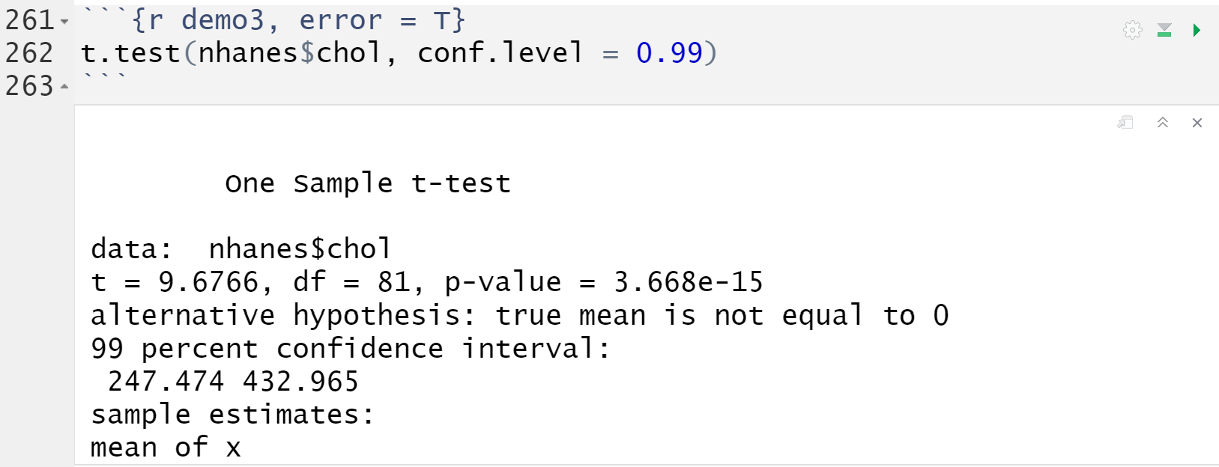
Demo #2
Notes:
False! We ignore the top portion of the output when creating a confidence interval. We will see how to calculate the multiplier next.

Slide 36
Interpretations
The 99% confidence interval is: (247.474 mg, 432.965 mg).
Confidence Interval
With 99% confidence, we estimate that the population mean cholesterol level for NHANES participants is between 247.474 and 432.965 milligrams
Confidence Level
If we repeated this procedure many times, we would expect 99% of these resulting confidence intervals to contain the population mean cholesterol level for NHANES participants.

Slide 37
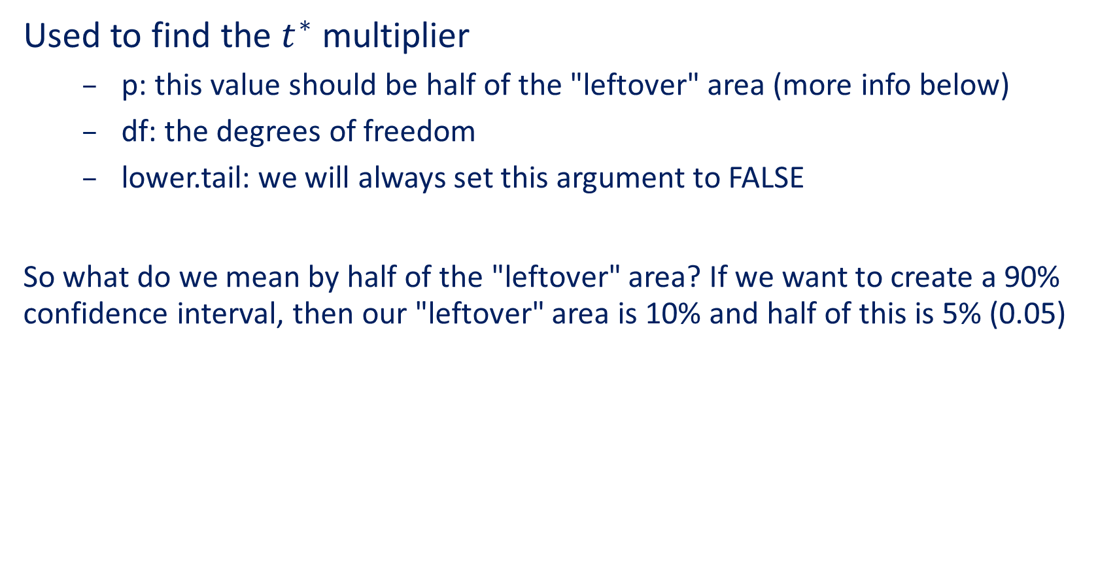
qt()
Used to find the $t^{∗}$ multiplier
p: this value should be half of the "leftover" area (more info below)
df: the degrees of freedom
lower.tail: we will always set this argument to FALSE
So what do we mean by half of the "leftover" area? If we want to create a 90% confidence interval, then our "leftover" area is 10% and half of this is 5% (0.05)

Slide 38
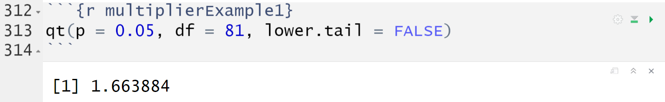
qt()
The following code was used to find the t* multiplier for creating the 90% confidence interval for population mean height.

Slide 39
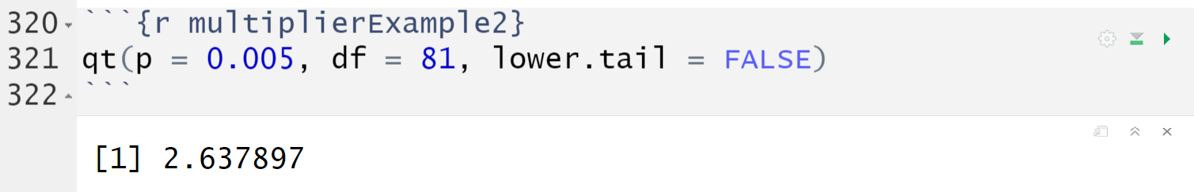
qt()
The following code was used to find the t* multiplier for creating the 99% confidence interval for population mean height.

Slide 40
Demo #3
Find the t* multiplier used to create the 95% confidence interval for the population mean cholesterol level for the NHANES participants.

Slide 41
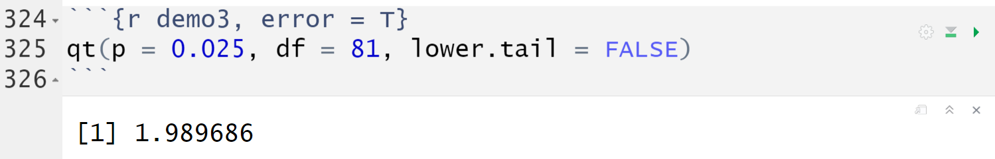
Demo #3
Find the t* multiplier used to create the 95% confidence interval for the population mean cholesterol level for the NHANES participants.

Slide 42
Hypothesis Tests
A hypothesis test helps us judge whether or not a statement about a population is reasonable or not. The procedure for running any hypothesis test involves four steps:
Determine appropriate null and alternative hypotheses
Check the assumptions for performing the test
Calculate the observed sample proportion and the test statistic. Then, determine the p-value.
First, evaluate the p-value and determine the amount of evidence against the null hypothesis. Then, make a conclusion in the context of the problem.

Slide 43

Hypothesis Testing
Our hypotheses for testing one population mean would be:
$H_{0}: μ=μ_{0} vs. H_{a}:μ>μ_{0}$
$H_{0}:μ=μ_{0} vs. H_{a}:μ<μ_{0}$
$H_{0}:μ=μ_{0} vs. H_{a}:μ≠μ_{0}$

Slide 44

Hypothesis Testing
The test statistic would be computed as:
$$t=\frac{\overline{x}−μ_{0}}{s.e.\left(\overline{x}\right)}=\frac{\overline{x}−μ_{0}}{s/{\sqrt{n}}}$$
The distribution of the test statistic under the null hypothesis is:
$$t\left(df\right)=t\left(n−1\right)$$

Slide 45
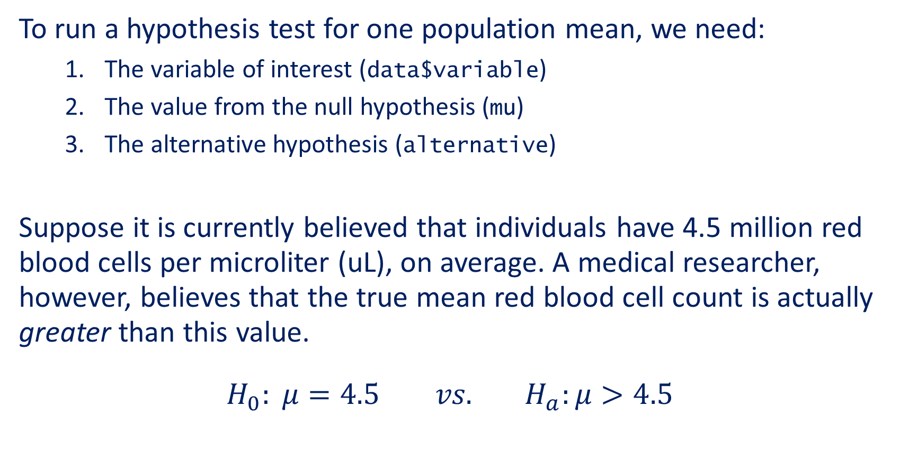
t.test()
To run a hypothesis test for one population mean, we need:
The variable of interest (data$variable)
The value from the null hypothesis (mu)
The alternative hypothesis (alternative)
Suppose it is currently believed that individuals have 4.5 million red blood cells per microliter (uL), on average. A medical researcher, however, believes that the true mean red blood cell count is actually greater than this value.
$$H_{0}: μ=4.5 vs. H_{a}:μ>4.5$$
Notes:
Write out the null and alternative hypothesis

Slide 46
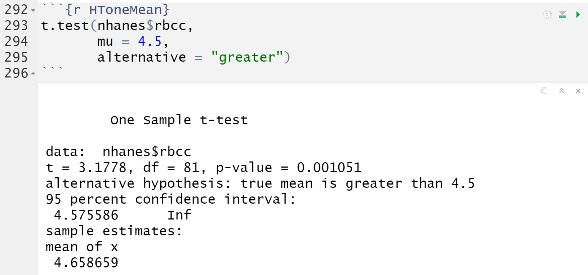
t.test()
The function once again gives us more information than we need

Slide 47
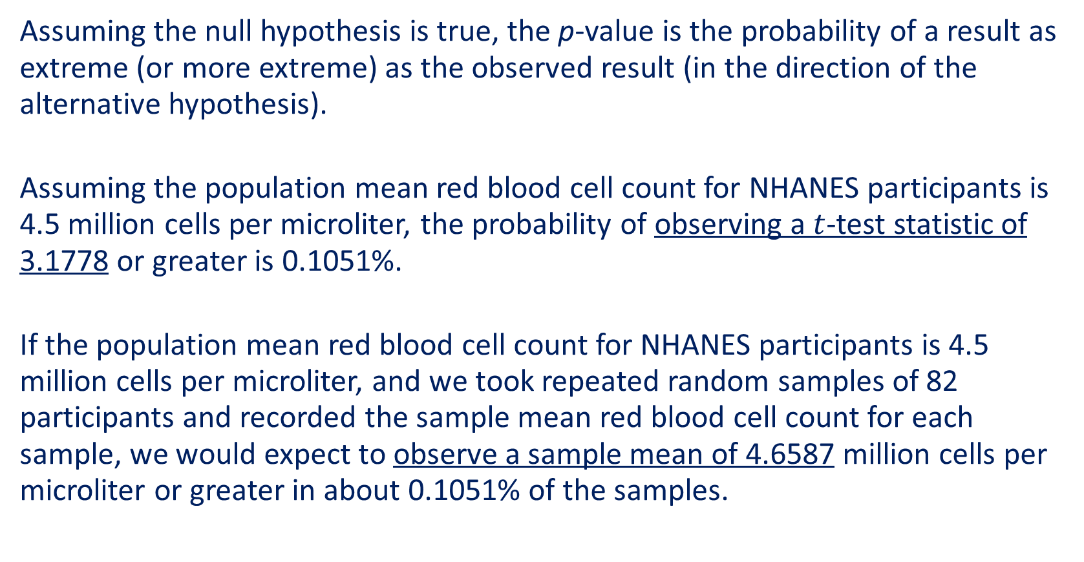
p-value
Assuming the null hypothesis is true, the p-value is the probability of a result as extreme (or more extreme) as the observed result (in the direction of the alternative hypothesis).
Assuming the population mean red blood cell count for NHANES participants is 4.5 million cells per microliter, the probability of observing a $t$-test statistic of 3.1778 or greater is 0.1051%.
If the population mean red blood cell count for NHANES participants is 4.5 million cells per microliter, and we took repeated random samples of 82 participants and recorded the sample mean red blood cell count for each sample, we would expect to observe a sample mean of 4.6587 million cells per microliter or greater in about 0.1051% of the samples.

Slide 48
Conclusions
How do we evaluate these results?
With a p-value of 0.001051, there is very strong evidence against the null hypothesis and in support of the alternative hypothesis.
What can we conclude (in context)?
Based on the data, we have very strong evidence to suggest that the population mean red blood cell count is greater than 4.5 million cells per microliter for NHANES participants.

Slide 49
Demo #4
Suppose an old report claimed that the population mean caffeine amount was 150 milligrams and we wish to determine if this value has changed.
Think About It: If we had hypothesized that the population mean caffeine amount had decreased (compared to the claimed value in the old report), would we get a small or large p-value? Why?

Slide 50
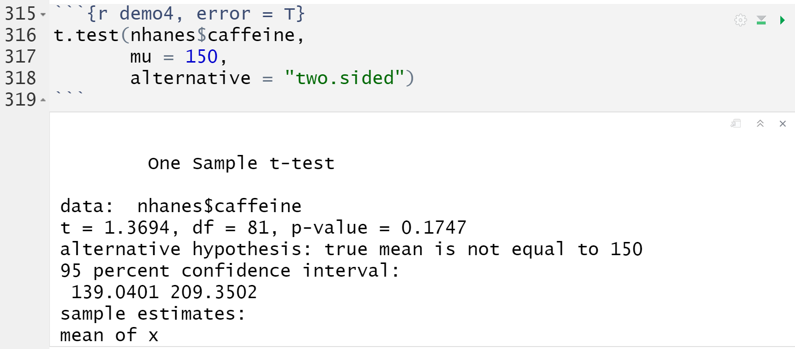
Demo #4
Notes:
Large! The bottom of the output gives us the sample mean of 174 milligrams. This value is greater than 150 so we would not have evidence to conclude that the population mean caffeine amount has decreased - meaning we would get a large p-value.

Slide 51
Think-Pair-Share #2
Consider the following statements:
Evaluation: With a p-value of 0.1747, there is not enough evidence against the null hypothesis and in support of the alternative hypothesis.
Conclusion: Based on the data, we can conclude that the population mean caffeine amount is 150 milligrams for NHANES participants.
Why is this conclusion inappropriate?
What should our conclusion be instead?
Notes:
We do not write the conclusion in terms of the null hypothesis. We are not providing evidence in support of the null - rather we are trying to provide evidence in support of the alternative. The conclusion should be written with respect to the alternative hypothesis.
Based on the data, we do NOT have enough evidence to suggest that the population mean caffeine amount has changed (from 150 milligrams) for all NHANES participants

Slide 52
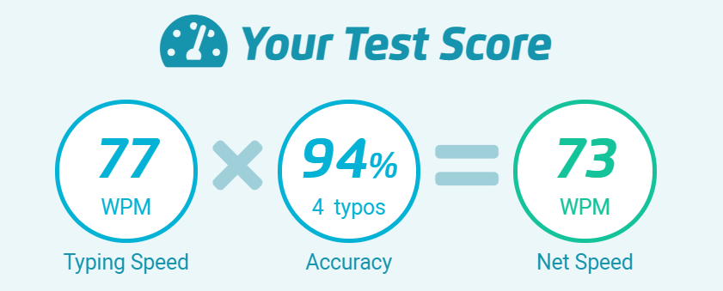
Typing Speeds
How fast can you type?
Head to: https://www.typingtest.com/
1 Minute Test
Medium Text
Notes:
GSIs – time permitting!

